Slide 1
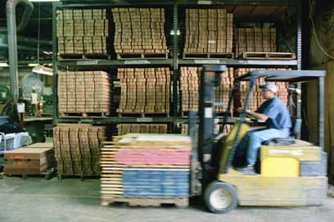

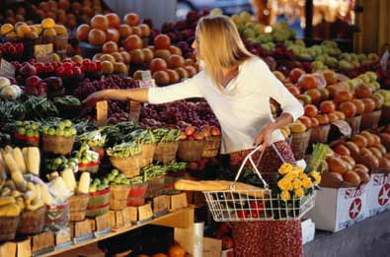

Assortment and Space Optimisation
Accelerate speed to market
Maximize inventory turn
Minimize supply chain costs

Slide 2

Agenda
Review of Range & Space Strategy and Approach
Review of Range & Space Solution
Summary
Q&A

Slide 3
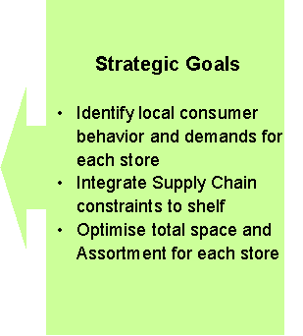
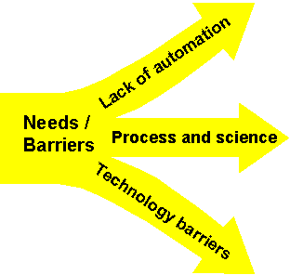

Today’s Market Situation
Customer demand, category strategy, visual communication and constraints in supply chain,
converging at the Store / Shelf

Slide 4
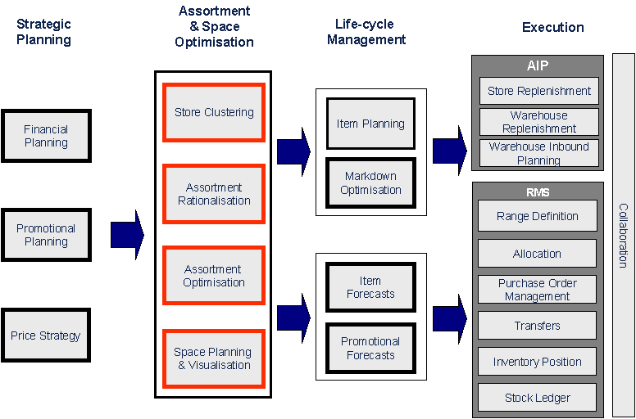
High-level process flow

Slide 5
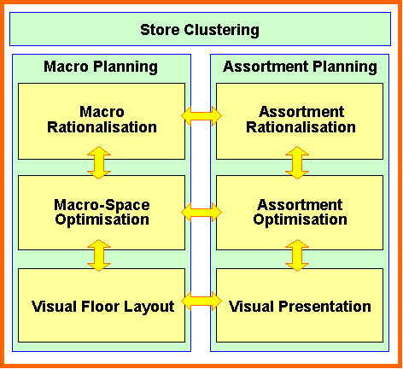
Assortment and Space Optimisation (ASO)
ASO is integrated with other key business processes and determines both high-level space strategies and specific item presentation by store.
Strategise
Optimise
Visualise

Slide 6
Agenda
Review of Range & Space Strategy and Approach
Review of Range & Space Solution
Summary
Q&A

Slide 7
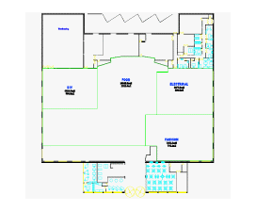
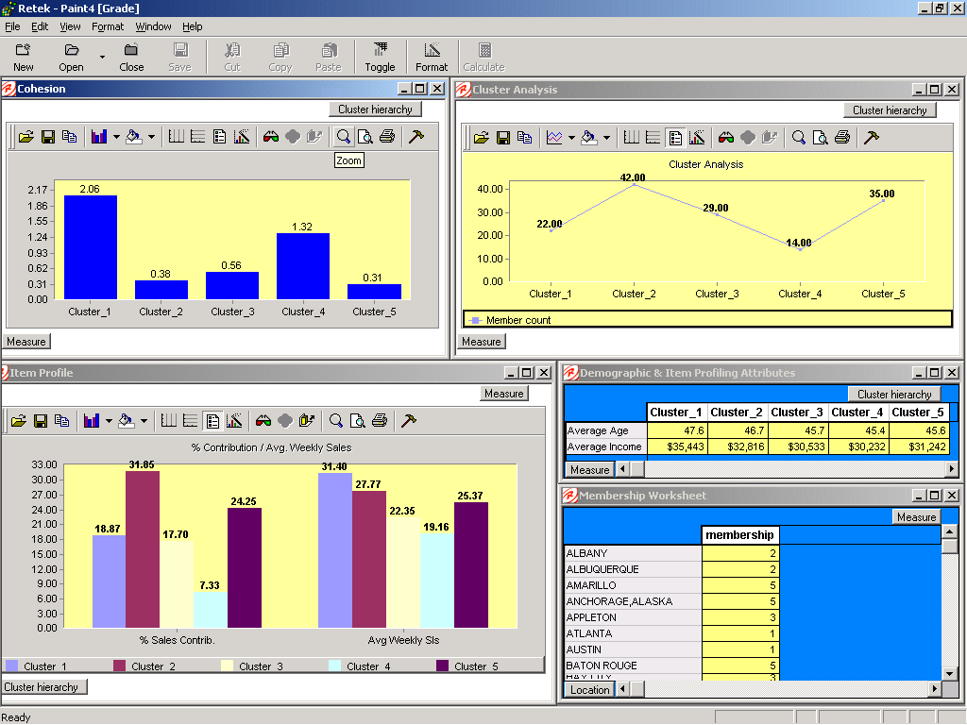
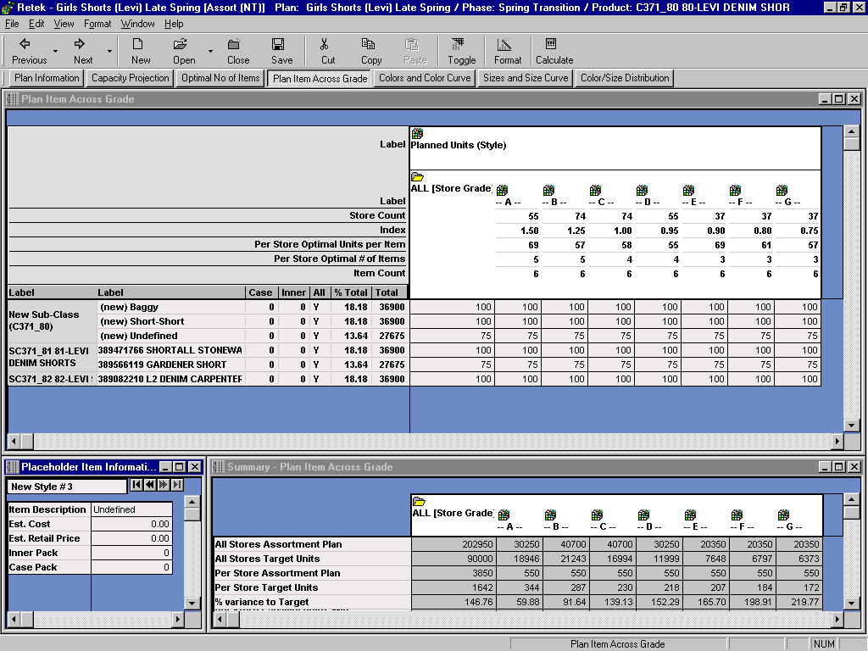
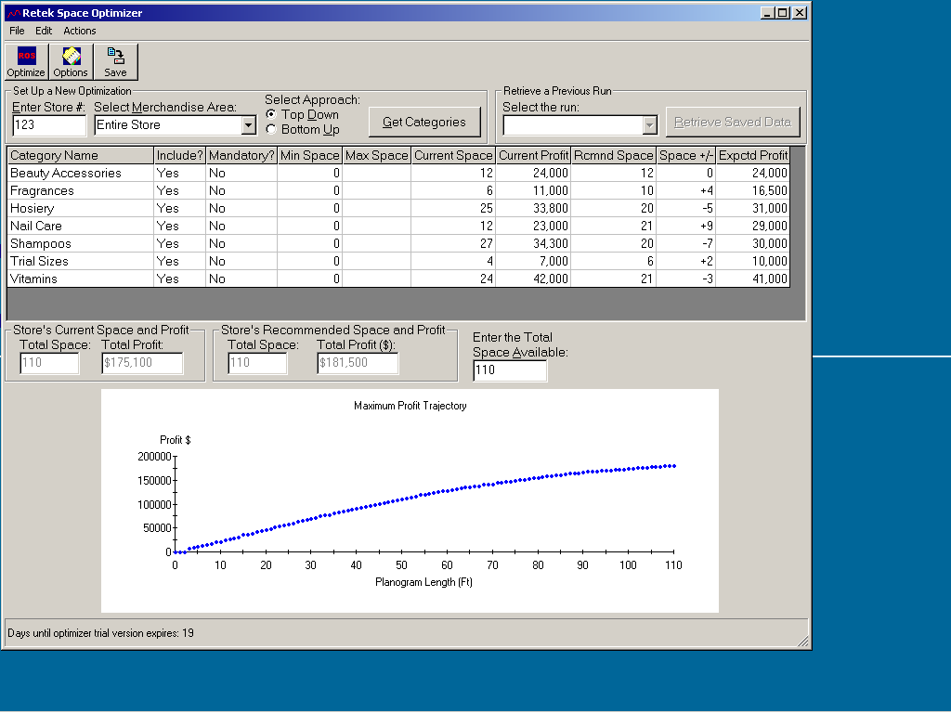
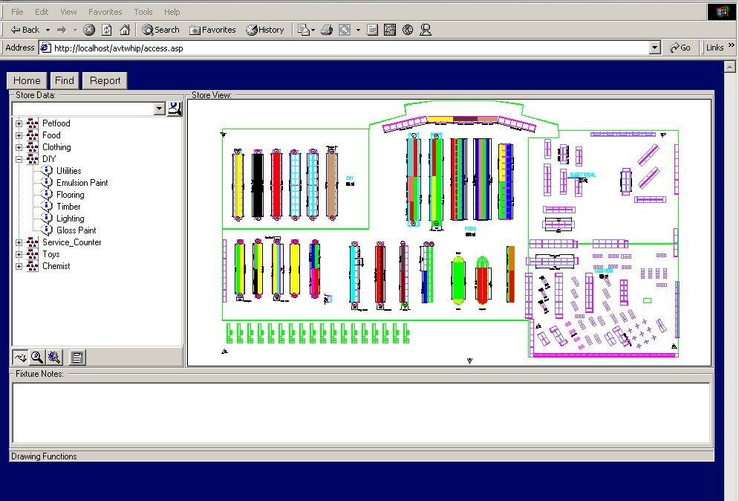
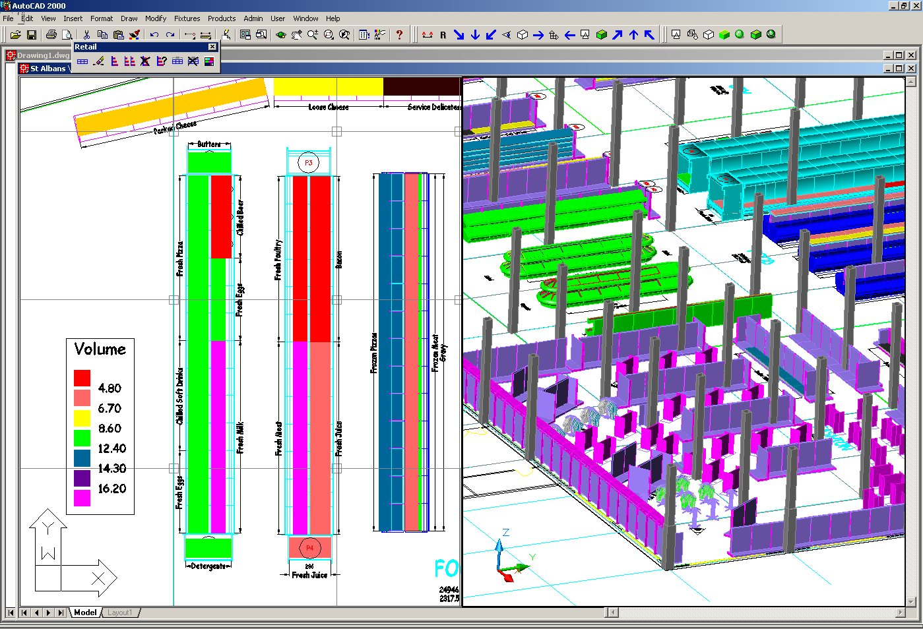
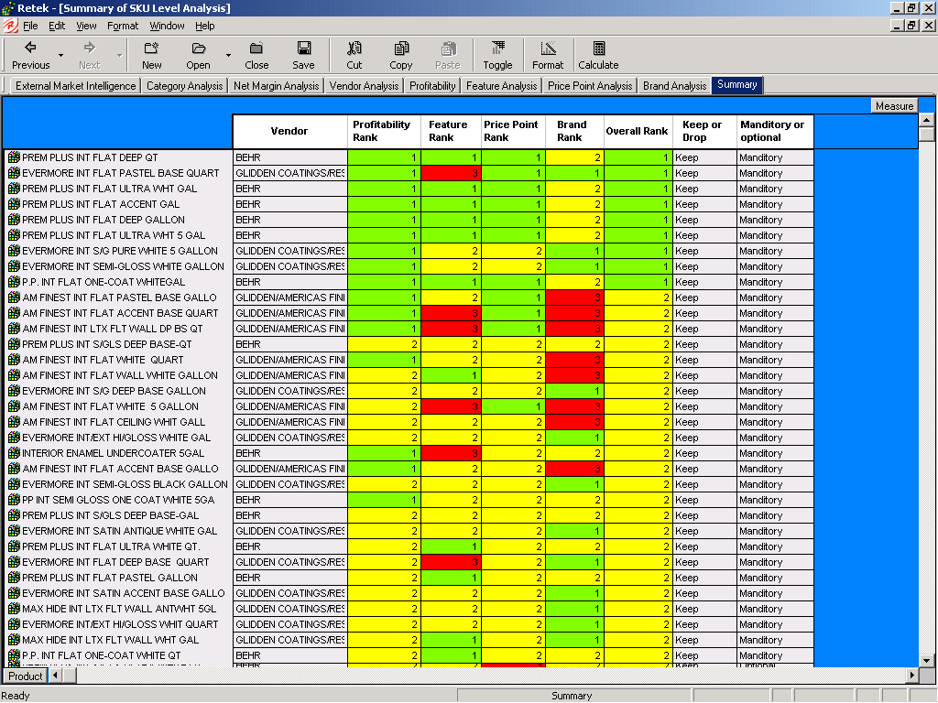
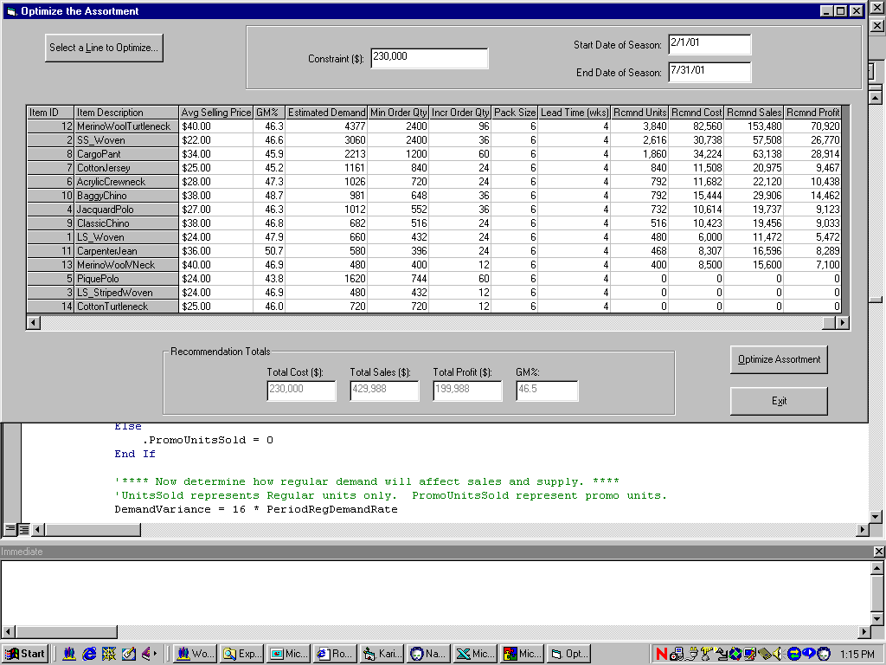
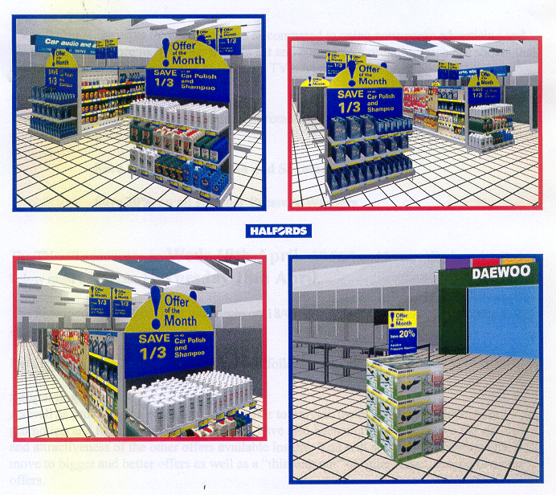
Full ASO Process
Identify Category / Segment roles and goals
Optimise Macro-Space
Identify and Analyse Space
Cluster Stores
Communicate to stores
Re-allocate Space
Rationalise Assortments
Optimise Assortments Profit/Space
Auto-fixture fill / Visual Merchandising
Assort
Visual Space Planning

Slide 8
Create Store Groups/Clusters
Stores are grouped based on store profile and characteristics of their consumer base
One Attribute
Multiple Attributes
Consumer demand patterns
4
Treat
each store differently
5
Potential Value
and Operational Complexity Increases
with Movement Up Hierarchy
2
Cluster like stores
based on customer behavior
1
3
Cluster like stores based on store attribute (e.g., customer demographics, location, etc.)
10-15,000 Sq. Ft Stores
Store
No.
Treat all stores
the same
All Categories
1
2
3
4
5
Rural-Lower Income
Suburban-High. Income
Rural-Lower Income
Suburban-High Income
Urban – Lower Income

Slide 9
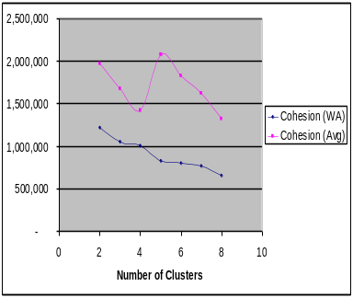
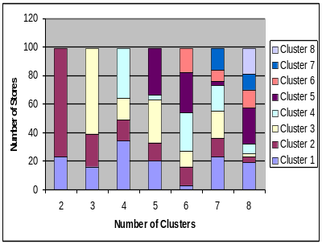
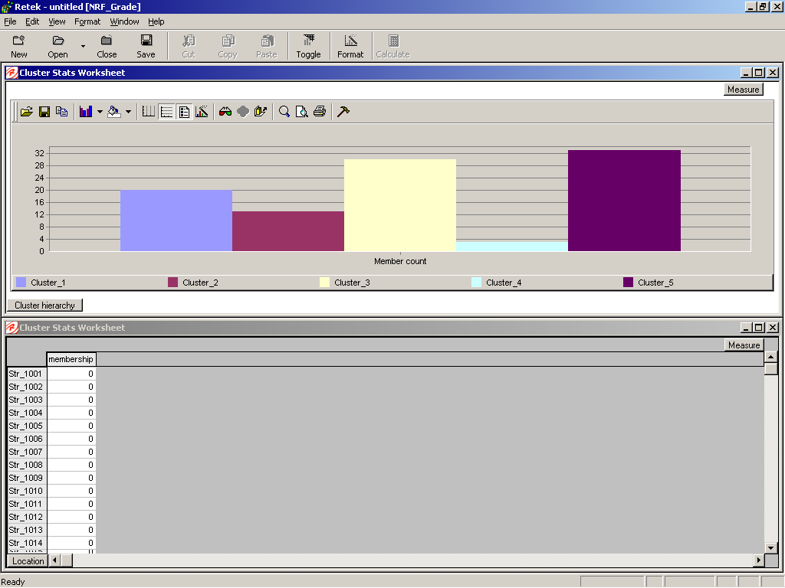
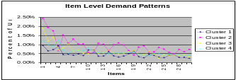
Assortment Planning - Create Store Clusters
Stores that contain similar item demand patterns are clustered together for the categories that are suited for local market assortments.
Item Demand Patterns
Store/Category Clustering
Create store groups in the Grade utility via a user friendly wizard
Stores are profiled by category based on similarities in item movement pattern
The tool helps to guide the user to select the right number of clusters
Cluster profiles such as membership, cohesion, SKU movement, size, location (urban/suburban/rural), market membership, etc
Store 1
Total Unit Sales
Store 2
Store 3
Store N
Items (1..N)

Slide 10
Assortment Planning - Create Store Clusters

Slide 11
Create Store Clusters - Example
This store/category clustering method will identify local market preferences, which are not easily identified with traditional store grouping.
- Before -
- Clustering Example -
- After -
Chips/Salty Snacks
Water Softener Salts
4
4
5
5
4
2
2
1
3
1
3
5
2
4
4
1
5
5
3
2
2
1
3
1
3
Hair Color
Liquid Laundry
Before
After
Store
No.
Chips/Salty
Snacks
Water Softener
Salts
Hair Color
Cereal
All Categories
1
2
3
4
5
Rural-Lower Income
Suburban-High. Income
Rural-Lower Income
Suburban-High Income
Urban – Lower Income
Pretzel Lovers
Traditional Tortillas
Crackers/Nuts
Healthy Snackers
Crackers/Nuts
Poor Water -- Rust
Poor Water -- Rust
Poor Water -- Potassium
Poor Water – Rust
Good Water
Hispanic colors
Caucasian colors
Hispanic colors
Hispanic colors
Caucasian colors
Chainwide Assortment
Chainwide Assortment
Chainwide Assortment
Chainwide Assortment
Chainwide Assortment

Slide 12
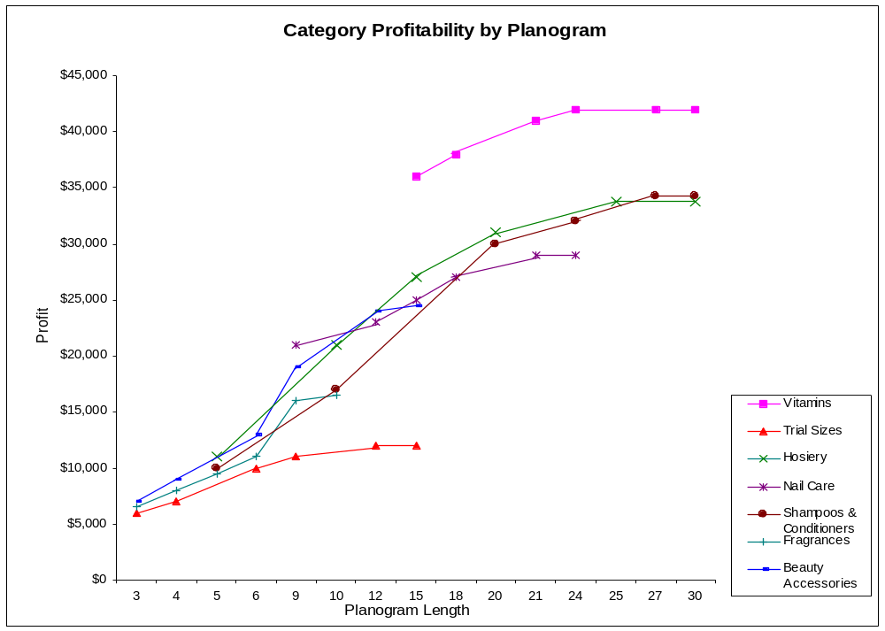

Macro-Space Planning - Determine Space Elasticity
Space elasticity is determined using regression analysis to understand how categories perform at different space allocations and/or planogram lengths.
Illustrative
The analysis gives the retailer insight to incremental returns on category space investments
The analysis can be performed on a chain-wide basis or with in store peer groups
Vitamins, 21ft
Hosiery, 20ft
Beauty Accessories, 12ft
Nail Care, 21ft
Shampoos & Conditioners, 20ft
Fragrances, 10ft
Trial Sizes, 6ft

Slide 13
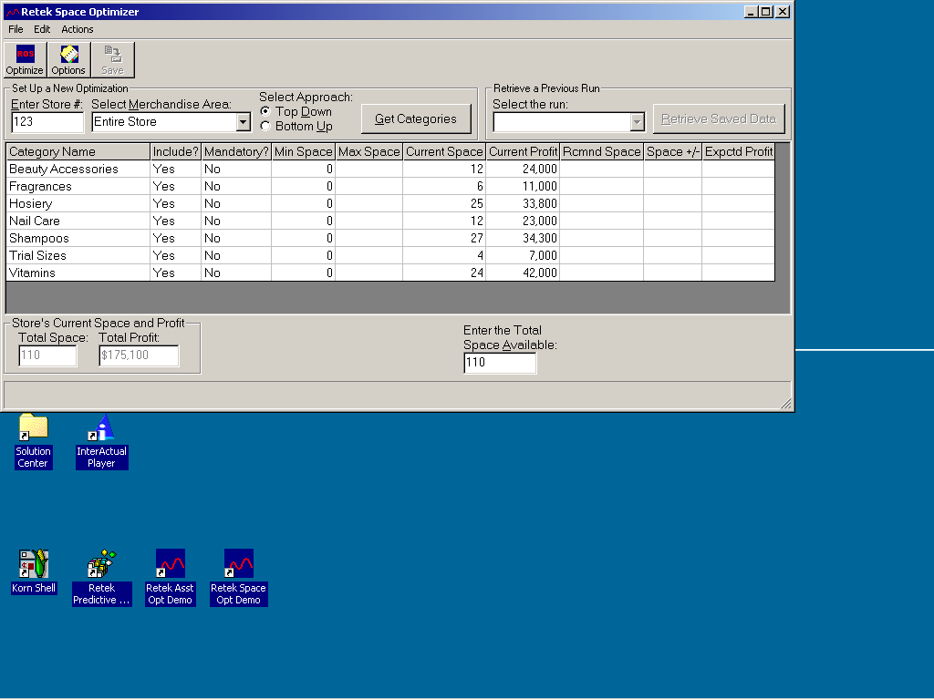
Macro-Space Planning - Optimise Space
Macro-Space Optimization determines the category space allocation combination which yields maximum profit. This is done using the advanced analytical techniques of the optimization engine.
The allocation is approached systematically by starting at a higher product level such as merchandise division or department and drilling down to the level that assortments are created, such as category and sub-category level
Financial objectives for a category are tied directly to the Floor Layout / Space allocation solution.
The application make space allocation change recommendations that need to be reconciled with actual floor plans

Slide 14
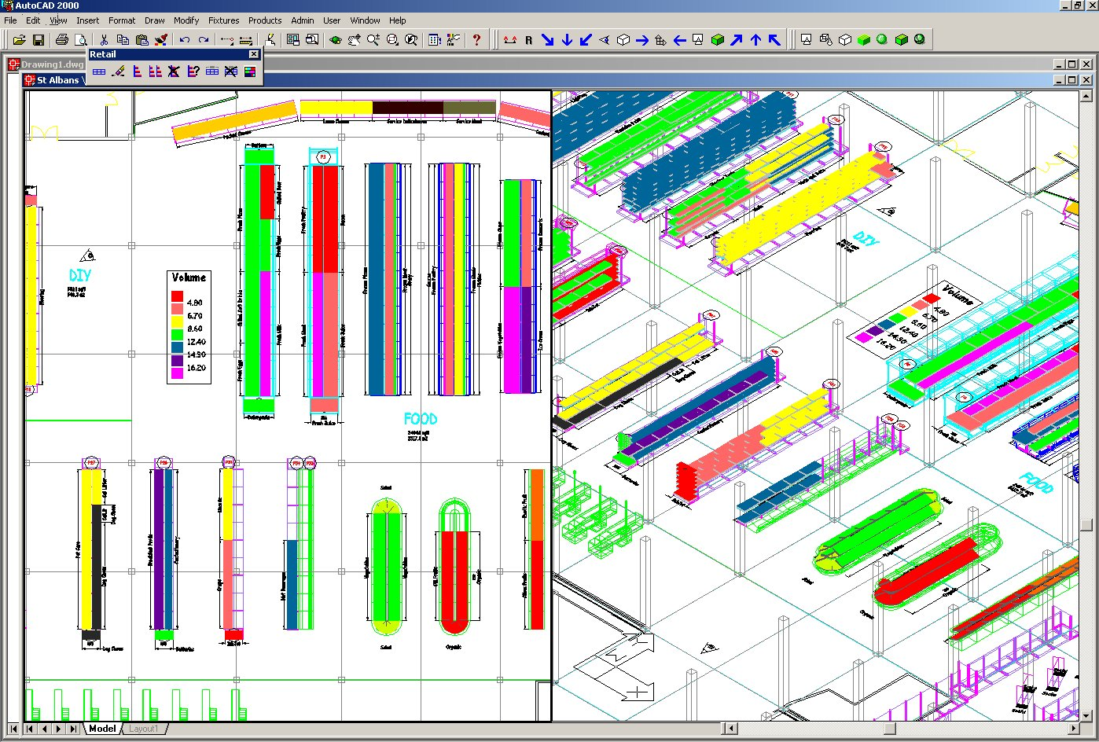
Macro-Space Planning - Floor Layout
The visual floor layout tool allows the retailer to reconcile space allocation change recommendations with actual floor plans.
To help the retailer visualise the space solutions the application incorporates a graphical floor layout tool to better understand:
  Physical constraints
  Category adjacencies
  Customer traffic flow
Outputs
  Physical Floor Layout
  Department to Category allocation and zone assignment
  Linear foot by category by store/ store group

Slide 15
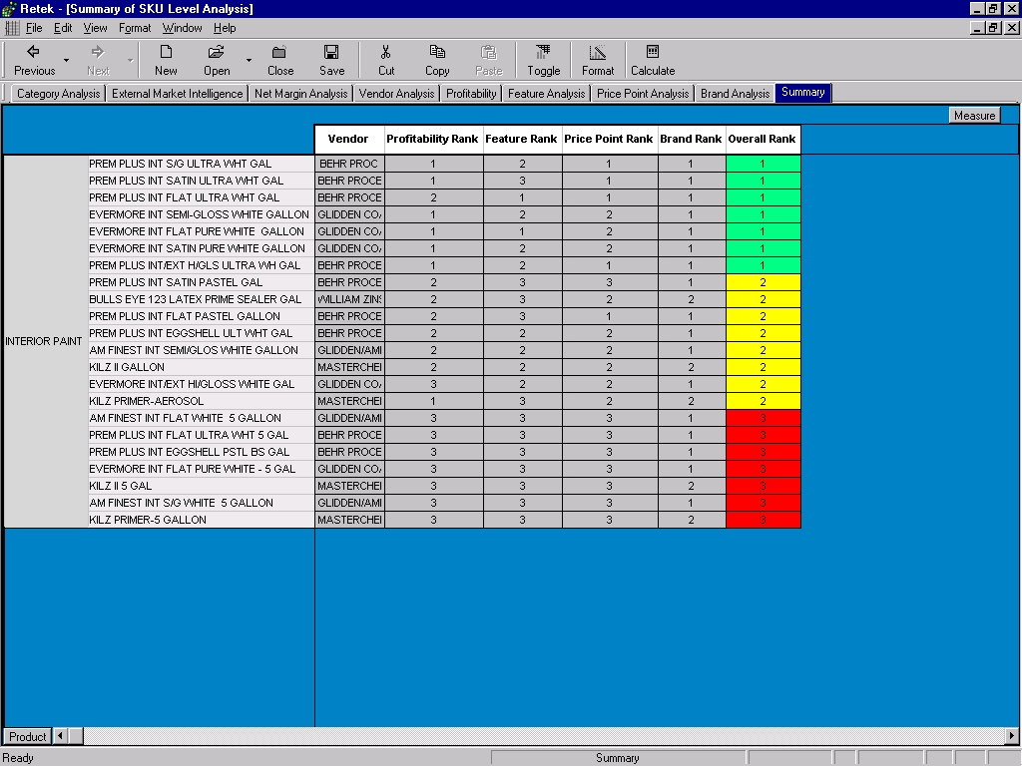
Assortment Planning - Assortment Rationalisation
Assortment Rationalisation is a disciplined analytical process which helps target items to keep, replace, or drop based on performance, relevance to targeted customers, and the roles of individual categories
Rationalisation can be performed on the chain or local market levels for both hardlines and fashion
Understand an item’s contribution (e.g., profit generation, customer satisfaction, market leadership), gaining insights to plan future assortments
Identify overall top performing items, top performers in local markets or items that should be in all stores for strategic reasons
Review historical performance by types of items (brand, price point, fabric type, color, trim, etc.) and competitive or external marketplace
The output is a Targeted assortment via a list of skus to consider and a list of skus to drop. Dropped SKU’s are flagged for markdown optimization

Slide 16
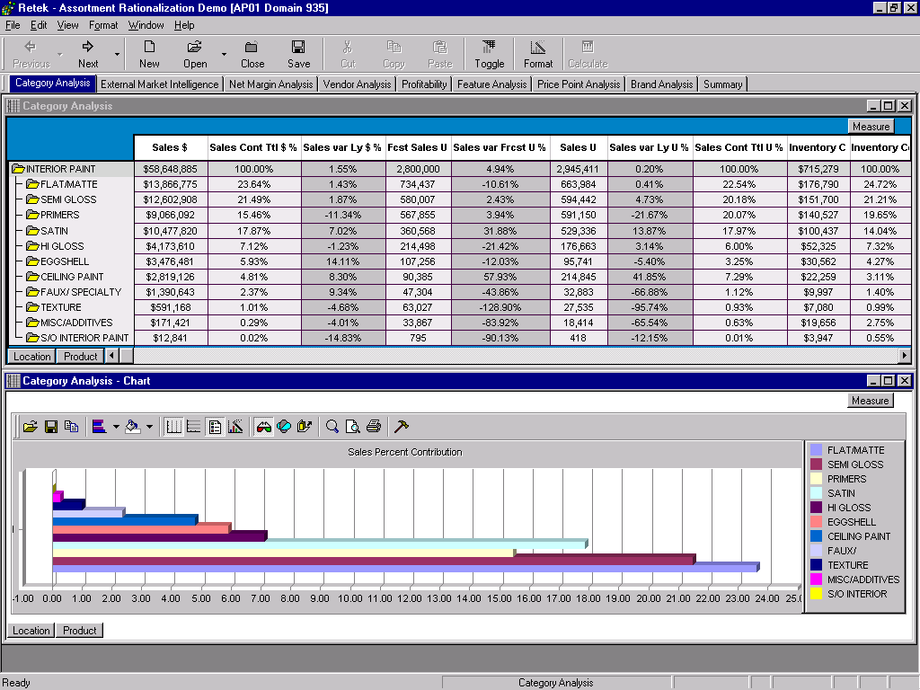
Assortment Planning - Assortment Rationalisation

Slide 17
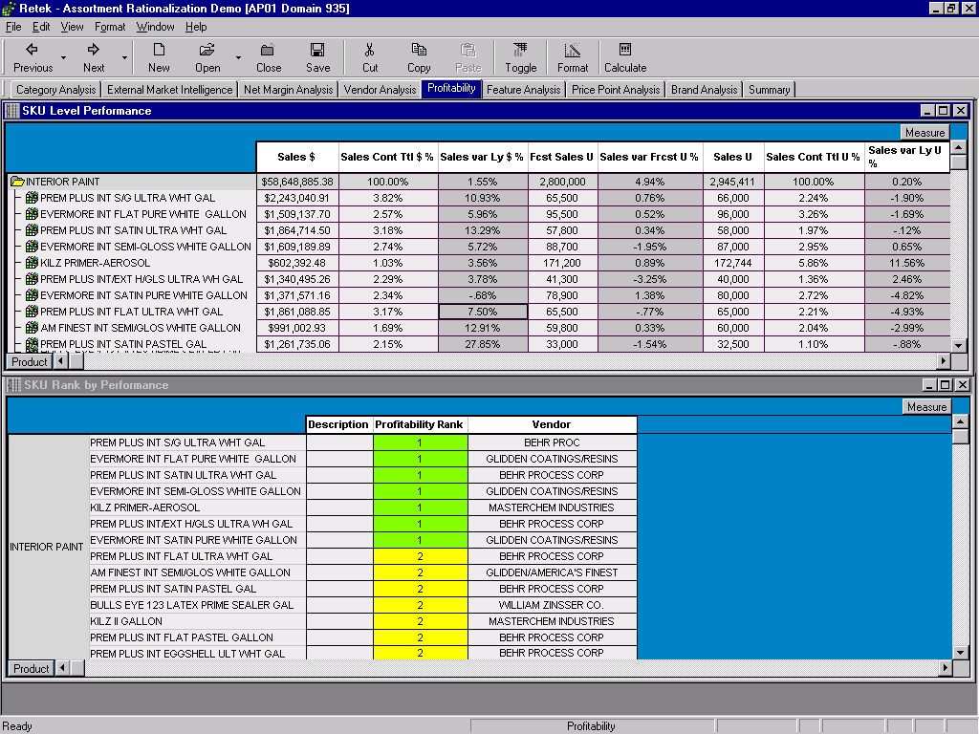
Assortment Planning - Assortment Rationalisation

Slide 18
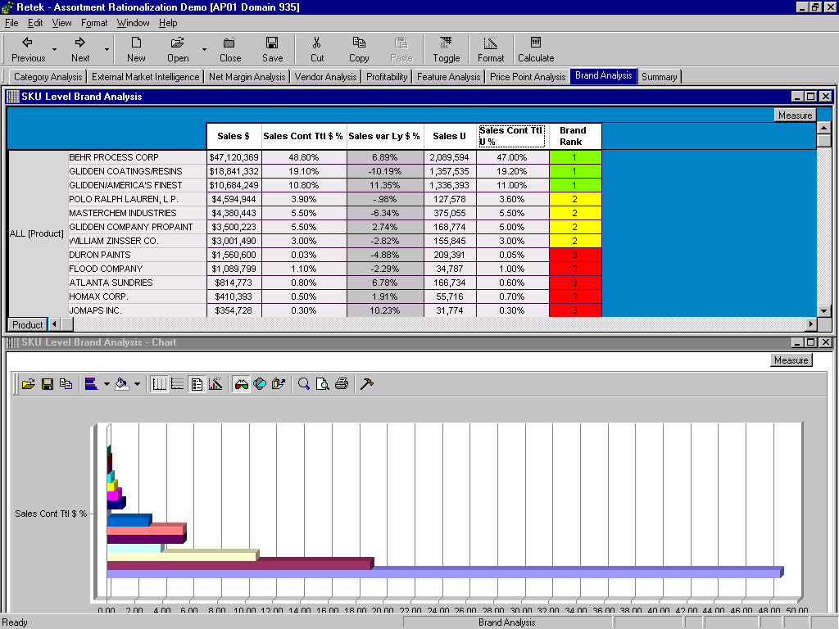
Assortment Planning - Assortment Rationalisation

Slide 19
Assortment Planning - Assortment Rationalisation

Slide 20
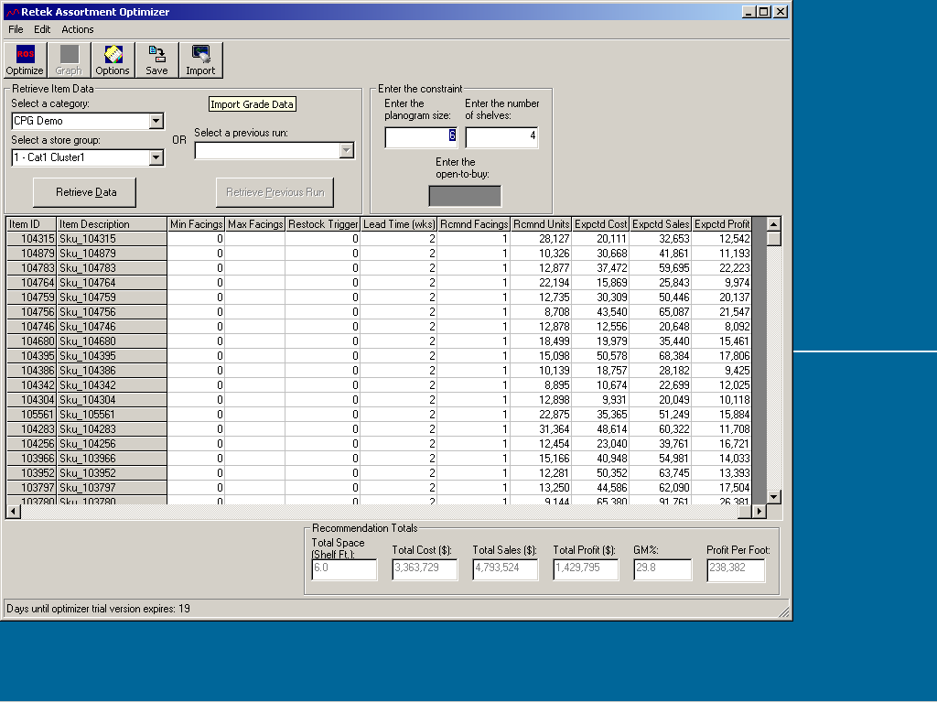
Assortment Planning - Optimise Assortment
Assortment optimisation typically uses forecasted demand and applied constraints to build the most profitable assortment to meet consumer demand.
Category Assortment Optimization
Ability to optimise on financial metrics (OTB) or physical space constraints (shelf size)
Based on forecasted item demand
Determines item list and # of facings to be merchandised within each store/ store cluster
What if capability allowing user to add or delete items or facings to meet business objectives
“What if” functionality based on constrained or unconstrained economic profiling
Optimal Solution
Intuitive Solution
Net Profit
SKU # 2
SKU # 1
New SKU #3
1
2
3
4
5
6
7 8
Number of Facings
Assortments are optimized within space constraints
based on each item’s contribution to total category performance

Slide 21
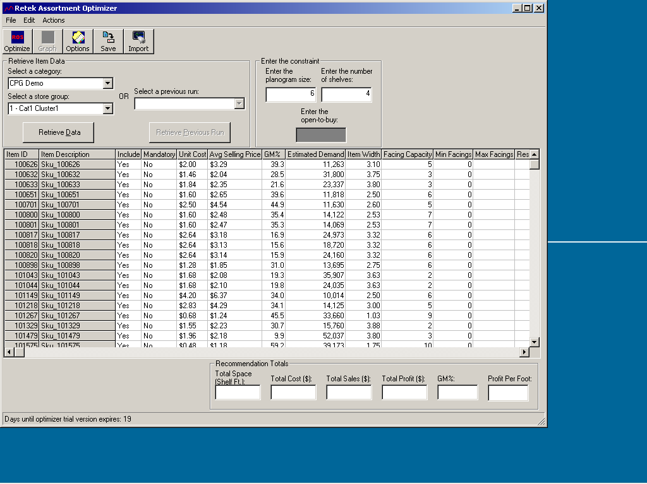
Assortment Optimisation

Main constraint for optimisation is selected (for example Space or Budget)
Œ
List of items to be optimised
Ž
When the Optimiser button is clicked, and the constraint is a planogram /shelf space limit, the optimiser will return the optimal number of facings for each item in the assortment.
In the case of the constraint being Budget, the profit for each item/quantity is calculated, and the optimiser finds the combination that maximises profit and fits within the constraint.

Slide 22
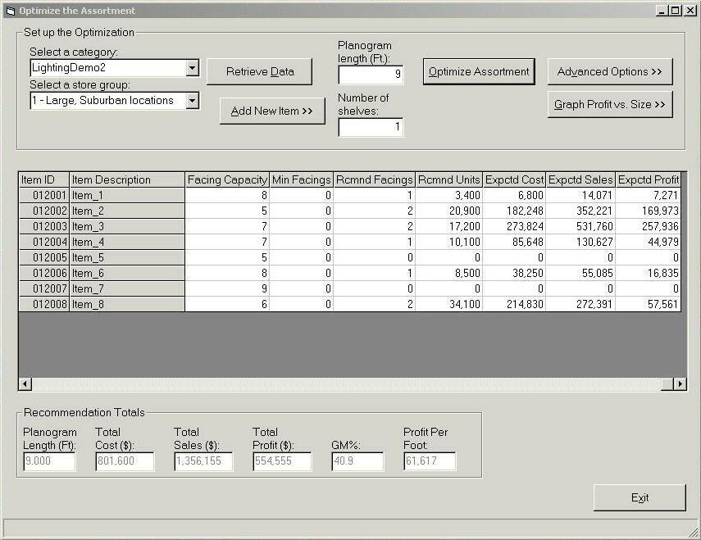
Assortment Optimisation

Slide 23
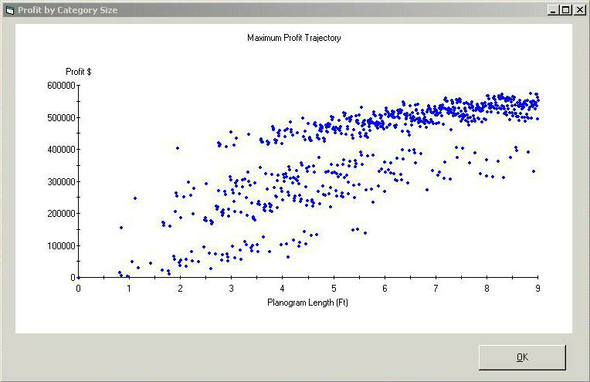
Assortment Optimisation

Slide 24
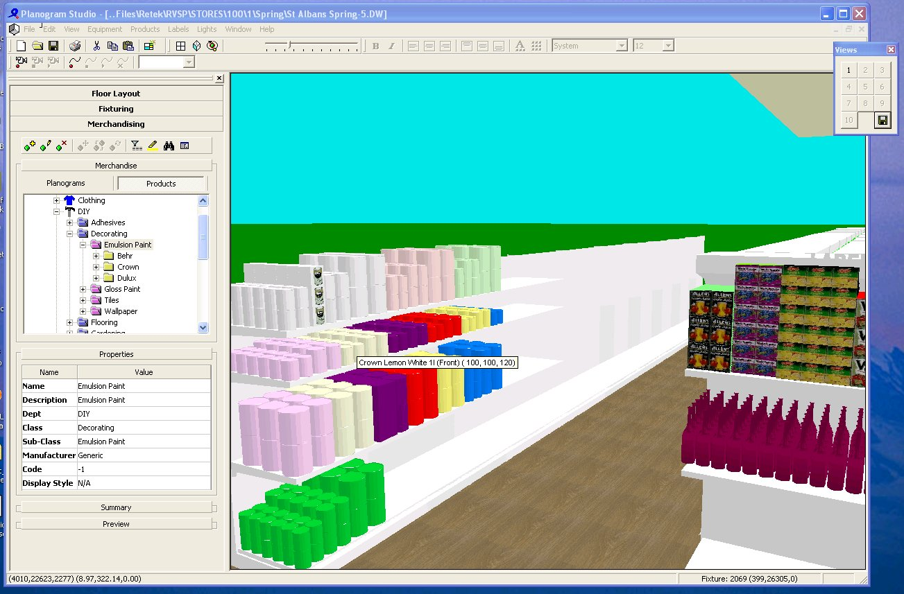
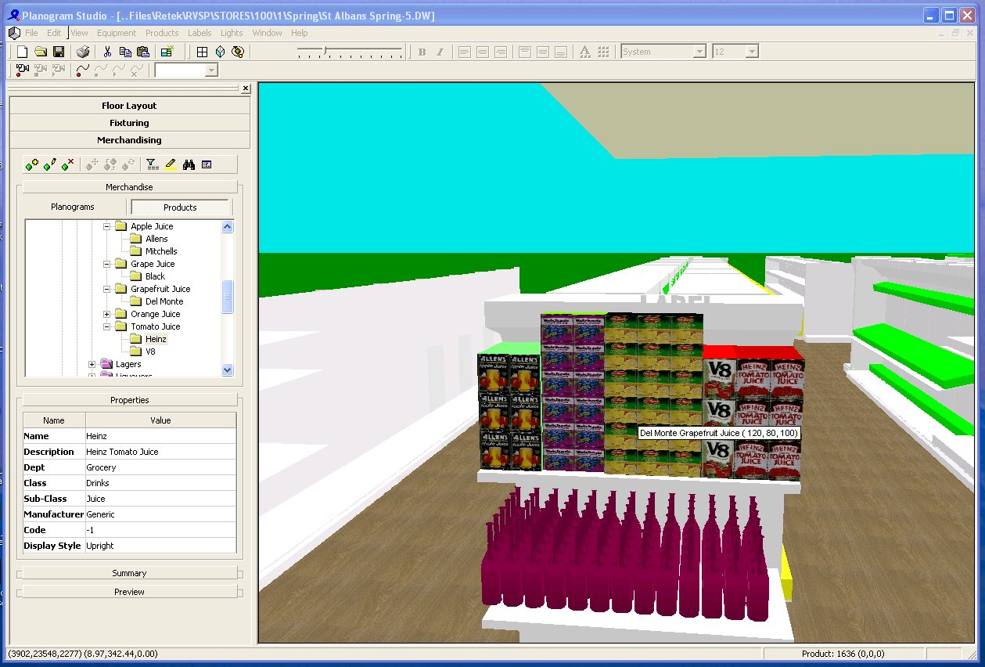
Assortment Planning - Visual Presentation
Once the assortment is determined, Visual Presentation facilitates a planogram view of the merchandise to help the retailer plan fixtures for organization, balance, and theme.
Optimized assortment visually placed on fixtures using rules based “auto fixture-fill” technology creating for automation and simplification
What if capabilities possible to create a planogram that meets business objectives and merchandising standards
A view of variance to optimal is available to deem if ‘re-optimizing’ is needed
Ability to adjust fixtures as needed and create product presentation standards
Planogram information communicated to the store for execution
Replenishment parameters updated based on approved presentation

Slide 25
Agenda
Review of Range & Space Strategy and Approach
Review of Range & Space Solution
Summary
Q&A

Slide 26
Full ASO Process
Identify Category / Segment roles and goals
Optimise Macro-Space
Identify and Analyse Space
Cluster Stores
Communicate to stores
Re-allocate Space
Rationalise Assortments
Optimise Assortments Profit/Space
Auto-fixture fill / Visual Merchandising
Assort
Visual Space Planning

Slide 27
Assortment and Space Optimization Summary
The Scientific Retailing approach to creating assortments through Assortment and Space Planning will help improve top and bottom line profitability as well as increase customer satisfaction.
Today’s Traits
Scientific Retailing Approach
Space Identification
Location Clustering
Category and SKU analysis
Store / Space Allocation
Assortment Selection
Planogram Creation
End User Effort
Space is identified one fixture at a time
Simple attributes of stores
Conducted randomly using various measures
May not reflect actual local customer demands
Subjective selection of items to serve store-level customers
Most common store/ category space occurrences are identified
Labor intensive effort and inaccurate placement of products
Accurately identify and optimise total space within each store
Predicted consumer behavior at Store/Item within category
Best practice process using retailers specific Key Performance Indicators
Optimised and re-allocated by category, meeting local customer demands
Demand driven item selection for each category’s specific customer
Individual store space is optimised for each category
Automated process of placing products on the shelves with virtual product movement
LOW
BENEFIT
HIGH

Slide 28
Customer Results
Significant revenue, profit and inventory benefits can be generated through optimized Assortments and Space
Benefits
Clients
Increase Revenue 10–20%
  Reallocating space to growing categories/SKU’s
  Keeping in stock merchandise the customer is buying
National Drug Store Chain
Increase Margin 5–15%
  Focusing assortments on higher margin items
  Investing markdown dollars in planned promotions rather than in clearing items
National Department Store Chain
Reduce Inventory 5–10%
  Cutting back on Space where categories/SKU’s do not meet the customers wants or needs
  Pruning non-revenue producing items from the assortment
Regional Grocery Store Chain
Increase Gross Profit Return on Space 10-20%

Slide 29
Agenda
Review of Range & Space Strategy and Approach
Review of Range & Space Solution
Summary
Q&A

